Slide 1
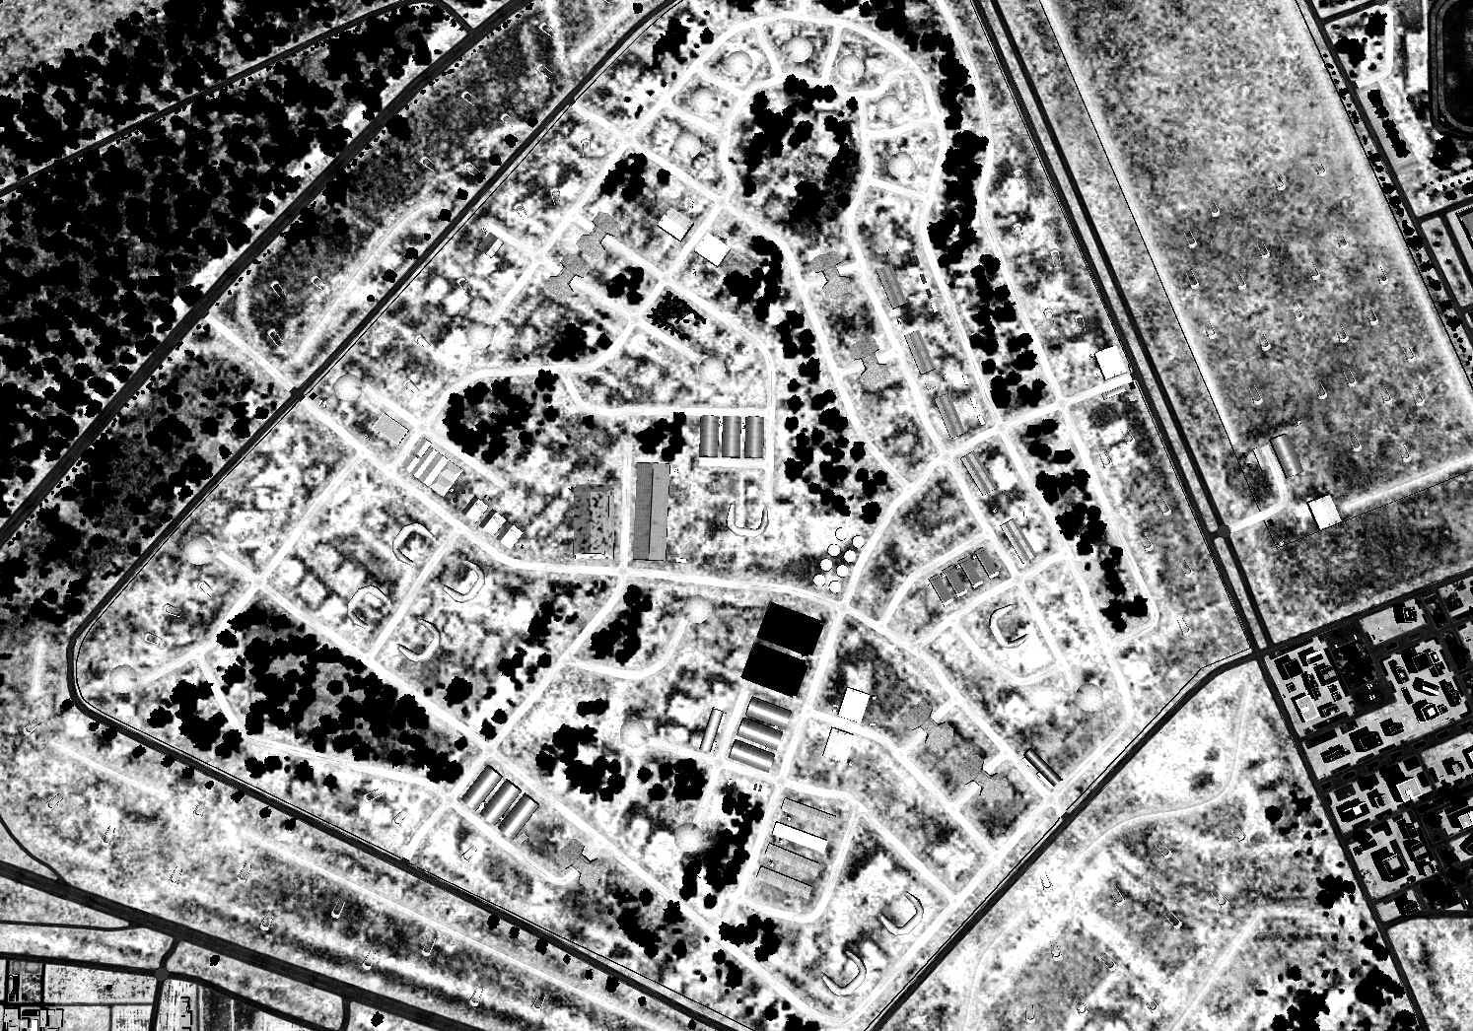

OPARTGT003, 922nd SCUD regiment base
N
MAP / WHERE THE TGT IS LOCATED
HQ building
TEL storage buildings
2
1
Administrative buildings
SCUD-TEL can be situated in their storage buildings or placed on the launch revetments prior to launching. TEL storage buildings are sheet metal buildings which offer little protection.
The SCUDs are fueled in the staging areas with IRFNA and Kerosene, both of which are needed for launch.
Any 500lbs bomb should be capable of destroying the buildings.
1
3
4
5
6
Collateral Damage Concern (CDC)
CDC 1, Civilian housings, 200m+ from nearest target building.
7
8

Slide 2
OPARTGT003, 922nd SCUD regiment base
N
MAP / WHERE THE TGT IS LOCATED
HQ building
IRFNA storage bunkers
2
Warhead
bunkers
1
Kerosene tanks
Warhead and IRFNA bunkers are concrete structures covered with sand.
All bunkers to be engaged with penetration capable ordnance, delayed fuzing GBU-31(V)3/B
Kerosene tanks are ordinary liquid tanks made of metal without protection, any 500lbs bomb should be capable of destroying the tanks.
1
3
4
5
6
CDE 1, Civilian housings
7
8

Slide 3
OPARTGT003, 922nd SCUD regiment base
N
MAP / WHERE THE TGT IS LOCATED
HQ building
Staging areas
2
1
Staging areas are used to top-up missiles and perform final inspection before launch.
Staging areas are concrete HAS type buildings covered with sand.
All staging areas are to be engaged with penetration capable ordnance, delayed fuzing GBU-31(V)3/B
1
3
4
5
6
CDC 1, Civilian housings
7
8

Slide 4
OPARTGT003, 922nd SCUD regiment base
N
MAP / WHERE THE TGT IS LOCATED
HQ building
Launch revetments
2
1
Fixed launch position are in the revetments. Launching from other locations is very likely when base is put on a higher alert status.
Revetments, if occupied by a TEL, can be engaged with any PGW.
1
3
4
5
6
CDE 1, Civilian housings
7
8

Slide 5
OPARTGT003, 922nd SCUD regiment base
N
MAP / WHERE THE TGT IS LOCATED
HQ building
Barracks
2
Repairshop
1
Barracks houses the operator crews, maintenance personnel and staff.
Repairshop can house a multitude of TEL in various states of readiness or repair
Warehouses store spare parts for both TEL and missile.
Any 500lbs bomb should be capable of destroying any of the buildings.
1
Major warehouses
3
Minor warehouses
4
5
6
CDE 1, Civilian housings
7
8

Slide 6
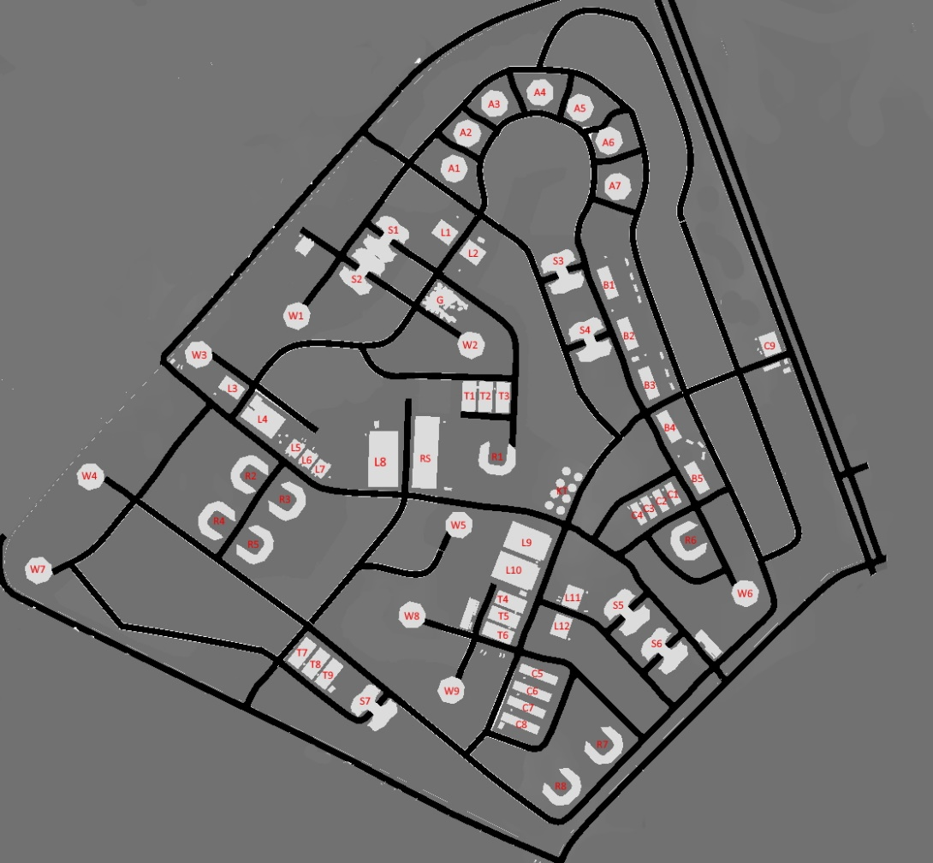
OPARTGT003, 922nd SCUD regiment base, Target list
N
All position N and E, all elevations 1427ft
TGT | Lat. | Long. | TGT | Lat. | Long. | TGT | Lat. | Long.
A1 | 36 10.763 | 37 04.901 | L3 | 36 10.595 | 37 04.698 | S6 | 36 10.403 | 37 05.106
A2 | 36 10.791 | 37 04.913 | L4 | 36 10.572 | 37 04.730 | S7 | 36 10.356 | 37 04.838
A3 | 36 10.814 | 37 04.936 | L5 | 36 10.550 | 37 04.785 | T1 | 36 10.592 | 37 04.919
A4 | 36 10.823 | 37 04.978 | L6 | 36 10.542 | 37 04.771 | T2 | 36 10.592 | 37 04.935
A5 | 36 10.812 | 37 05.018 | L7 | 36 10.535 | 37 04.783 | T3 | 36 10.592 | 37 04.951
A6 | 36 10.786 | 37 05.045 | L8 | 36 10.546 | 37 04.839 | T4 | 36 10.439 | 37 04.961
A7 | 36 10.752 | 37 05.053 | L9 | 36 10.484 | 37 04.975 | T5 | 36 10.426 | 37 04.956
B1 | 36 10.681 | 37 05.047 | L10 | 36 10.461 | 37 04.966 | T6 | 36 10.415 | 37 04.950
B2 | 36 10.642 | 37 05.066 | L11 | 36 10.442 | 37 04.019 | T7 | 36 10.397 | 37 04.768
B3 | 36 10.606 | 37 05.086 | L12 | 36 10.420 | 37 05.010 | T8 | 36 10.389 | 37 04.782
B4 | 36 10.572 | 37 05.106 | R1 | 36 10.549 | 37 04.946 | T9 | 36 10.381 | 37 04.794
B5 | 36 10.534 | 37 05.133 | R2 | 36 10.529 | 37 04.718 | W1 | 36 10.650 | 37 04.757
C1 | 36 10.552 | 37 05.110 | R3 | 36 10.511 | 37 04.750 | W2 | 36 10.631 | 37 04.920
C2 | 36 10.516 | 37 05.100 | R4 | 36 10.495 | 37 04.688 | W3 | 36 10.620 | 37 04.666
C3 | 36 10.511 | 37 05.089 | R5 | 36 10.479 | 37 04.721 | W4 | 36 10.527 | 37 04.568
C4 | 36 10.507 | 37 05.079 | R6 | 36 10.486 | 37 05.129 | W5 | 36 10.495 | 37 04.912
C5 | 36 10.384 | 37 04.987 | R7 | 36 10.333 | 37 05.050 | W6 | 36 10.448 | 37 05.180
C6 | 36 10.371 | 37 04.982 | R8 | 36 10.299 | 37 05.012 | W7 | 36 10.454 | 37 04.521
C7 | 36 10.539 | 37 04.978 | RS | 36 10.550 | 37 04.880 | W8 | 36 10.427 | 37 04.870
C8 | 36 10.347 | 37 04.971 | S1 | 36 10.711 | 37 04.839 | W9 | 36 10.371 | 37 04.908
C9 | 36 10.636 | 37 05.199 | S2 | 36 10.685 | 37 04.818
KT | 36 10.523 | 37 05.010 | S3 | 36 10.687 | 37 05.005
L1 | 36 10.716 | 37 04.893 | S4 | 36 10.636 | 37 05.031
L2 | 36 10.700 | 37 04.920 | S5 | 36 10.431 | 37 05.071
N
1
1
2
3
4
5
6
7
8

Slide 7
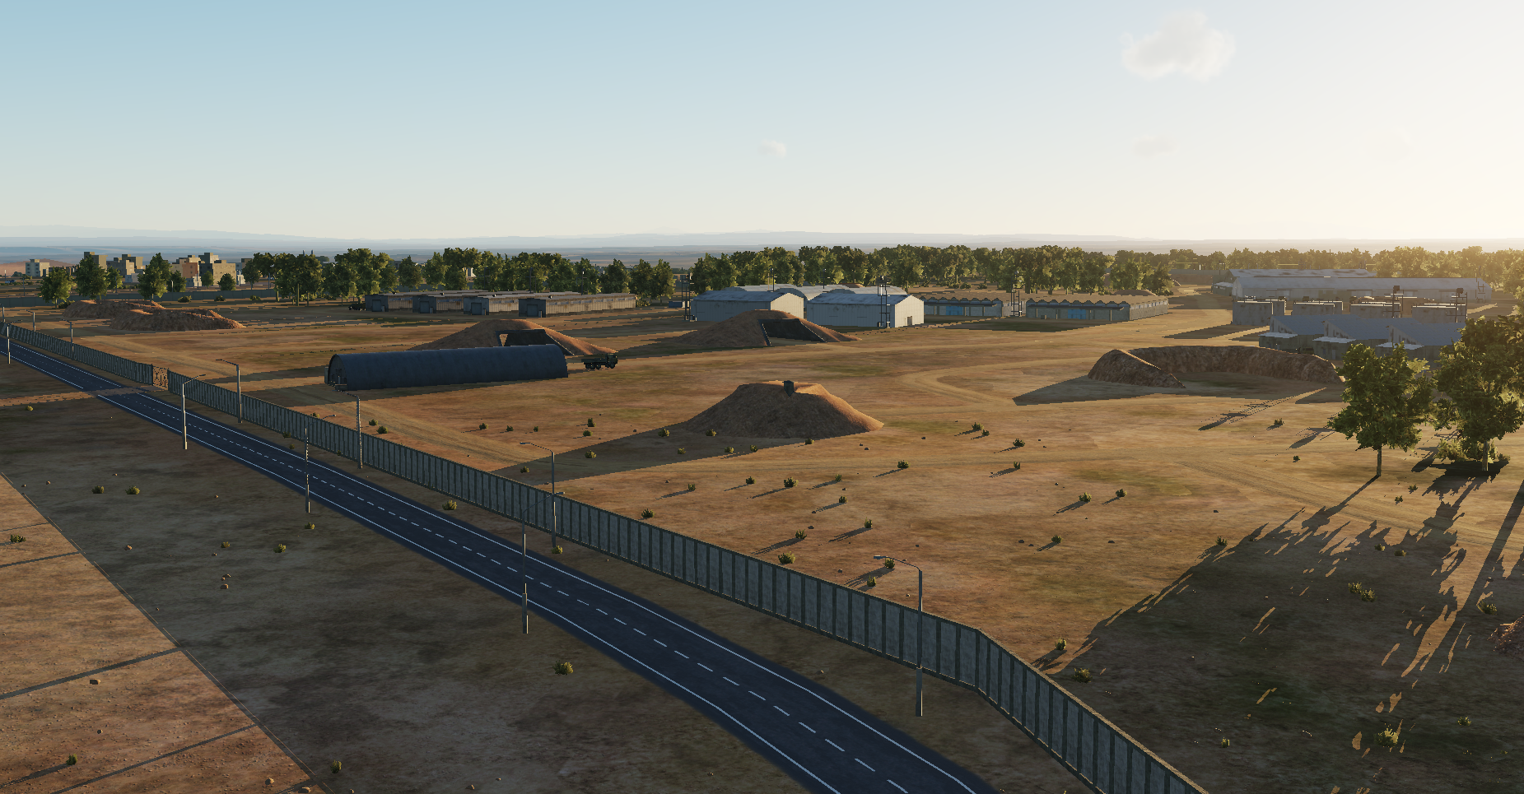
OPARTGT003, 922nd SCUD regiment base, HUMINT
N
N
Staging area Warhead bunker Revetment
1
1
2
3
4
5
6
7
8

